Slide 1


Slide 2

Necessity is the Mother of Invention

Slide 3
SUBJECT CODE:SCS1305 SOFTWARE ENGINEERING
UNIT 1 INTRODUCTION
UNIT 2 SOFTWARE ENGINEERING PROCESS
UNIT 3 DESIGN PROCESS AND CONCEPTS
UNIT 4 BASIC CONCEPTS OF SOFTWARE TESTING
UNIT 5 COST ESTIMATION & MAINTENENCE

Slide 4
UNIT 4
BASIC CONCEPTS OF SOFTWARE TESTING

Slide 5
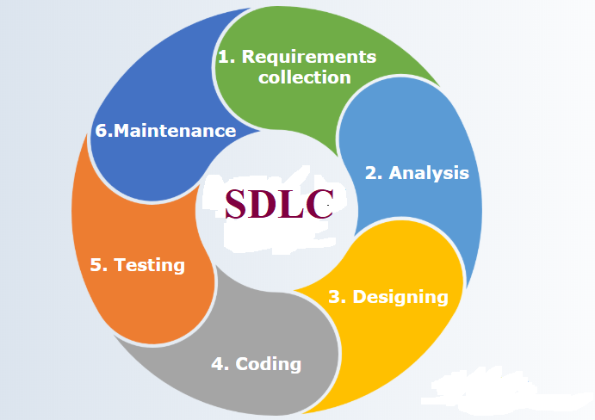

Slide 6
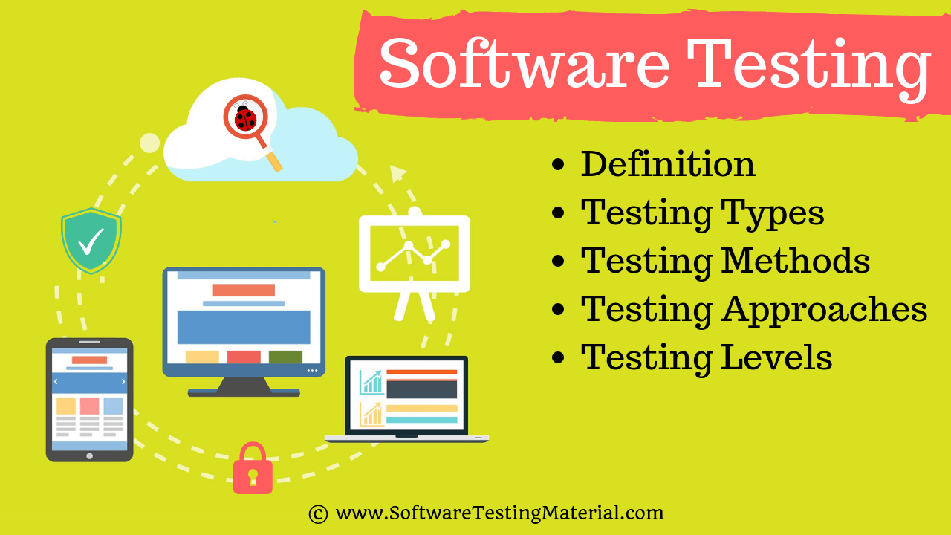

Slide 7
BASIC CONCEPTS OF SOFTWARE TESTING
Levels
Software Testing Fundamentals
Types of s/w test
White box testing
Basis path testing
Black box testing
Control Structure testing
Regression testing
Testing in the large S/W testing strategies
Strategic approach and issues
UNIT testing
Integration testing
Validation testing
System testing and debugging
Case studies
Writing black box and white box testing.

Slide 8
SOFTWARE TESTING
Software testing is a process, to evaluate the functionality of a software application with an intent to find whether the developed software met the specified requirements or not and to identify the defects to ensure that the product is defect free in order to produce the quality product.

Slide 9
Testing Objectives
Testing is a process of executing a program with the intent of finding an error.
A good test case is one that has a high probability of finding an as-yet undiscovered error.
A successful test is one that uncovers an as-yet-undiscovered error

Slide 10
Testing Principles
All tests should be traceable to customer requirements. Tests should be planned long before testing begins.
The Pareto principle applies to software testing
Testing should begin “in the small‖ and progress toward testing “in the large.
Exhaustive testing is not possible
To be most effective, testing should be conducted by an independent third party

Slide 11
Testability
Software testability is simply how easily [a computer program] can be tested
The checklist that follows provides a set of characteristics that lead to testable software.
Operability-"The better it works, the more efficiently it can be tested.
Observability - "What you see is what you test."
Controllability- "The better we can control the software, the more the testing can be automated and optimized.“
Decomposability.-"By controlling the scope of testing, we can more quickly isolate
problems and perform smarter retesting.
Simplicity-"The less there is to test, the more quickly we can test it.
Stability- "The fewer the changes, the fewer the disruptions to testing.
Understandability- "The more information we have, the smarter we will test."

Slide 12
What are the different Types of Software Testing? In →Tester perspective
We, as testers are aware of the various types of Software Testing such as Functional Testing, Non-Functional Testing, Automation Testing, Agile Testing, and their sub-types etc.
Each of us would have come across several types of testing in our testing journey. We might have heard some and we might have worked on some, but not everyone has knowledge about all the testing types.

Slide 13
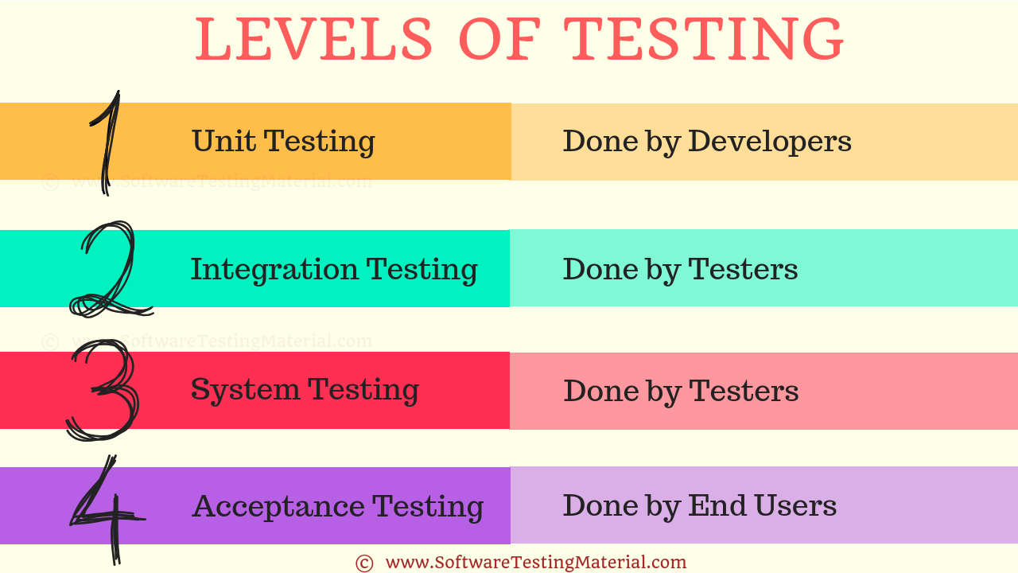
Levels

Slide 14
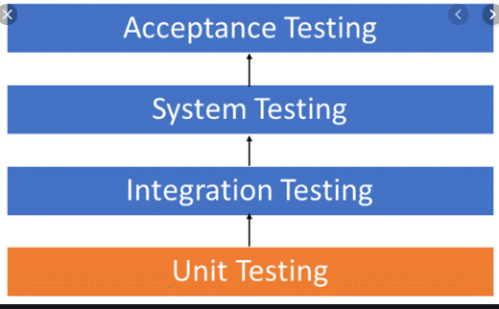
Levels of Testing

Slide 15
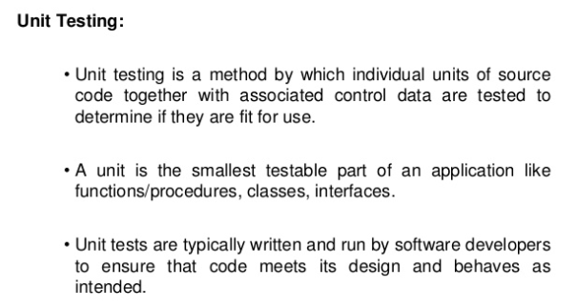
Unit Testing

Slide 16
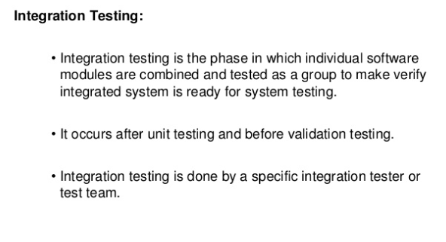
Integration Testing

Slide 17
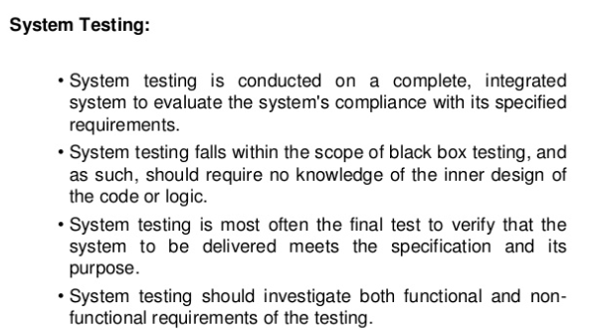
System Testing

Slide 18
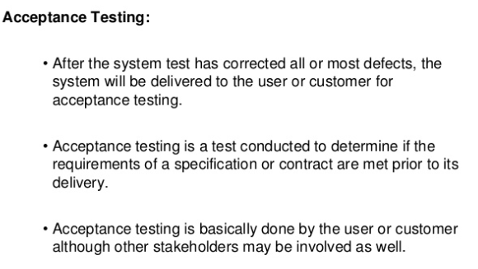
Acceptance Testing

Slide 19
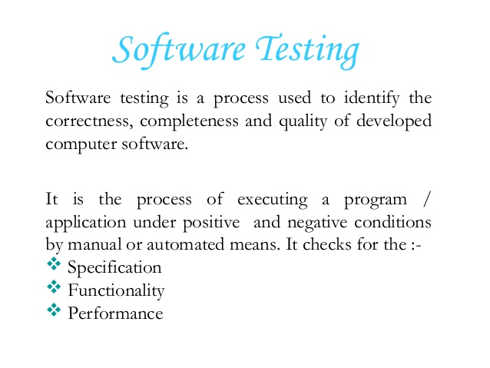
Software Testing Fundamentals

Slide 20
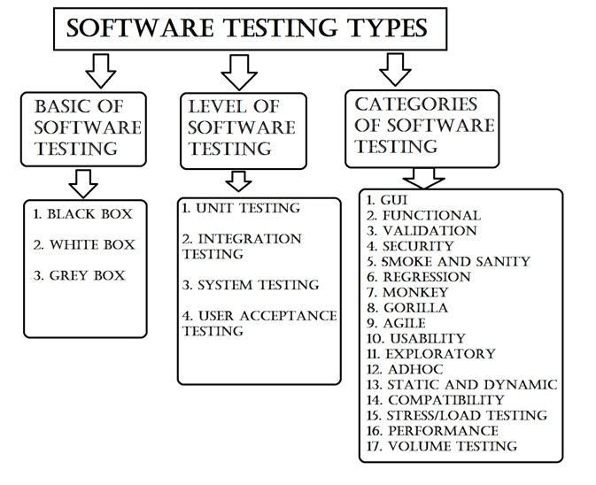
Types of s/w test

Slide 21
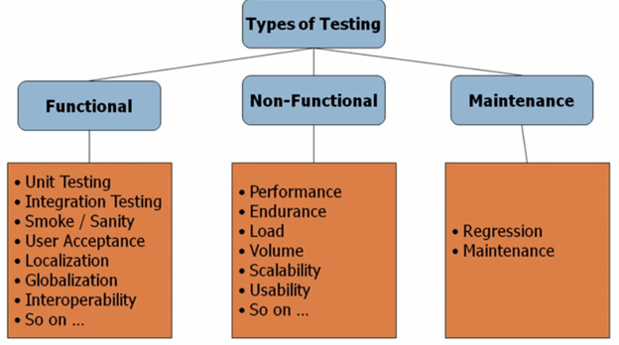
Types of s/w test

Slide 22
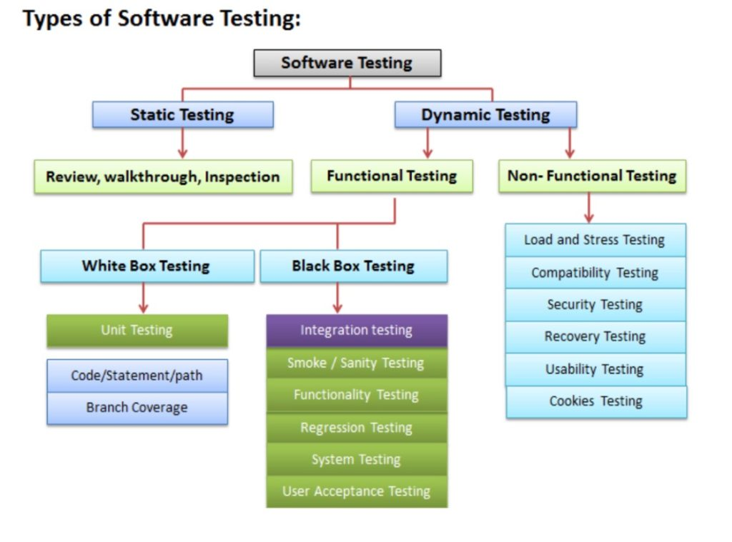
Types of s/w test

Slide 23
Different Types of Software Testing
Functional testing types include:
Unit testing
Integration testing
System testing
Sanity testing
Smoke testing
Interface testing
Regression testing
Beta/Acceptance testing
Non-functional testing types include:
Performance Testing
Load testing
Stress testing
Volume testing
Security testing
Compatibility testing
Install testing
Recovery testing
Reliability testing
Usability testing
Compliance testing
Localization testing

Slide 24


Slide 25
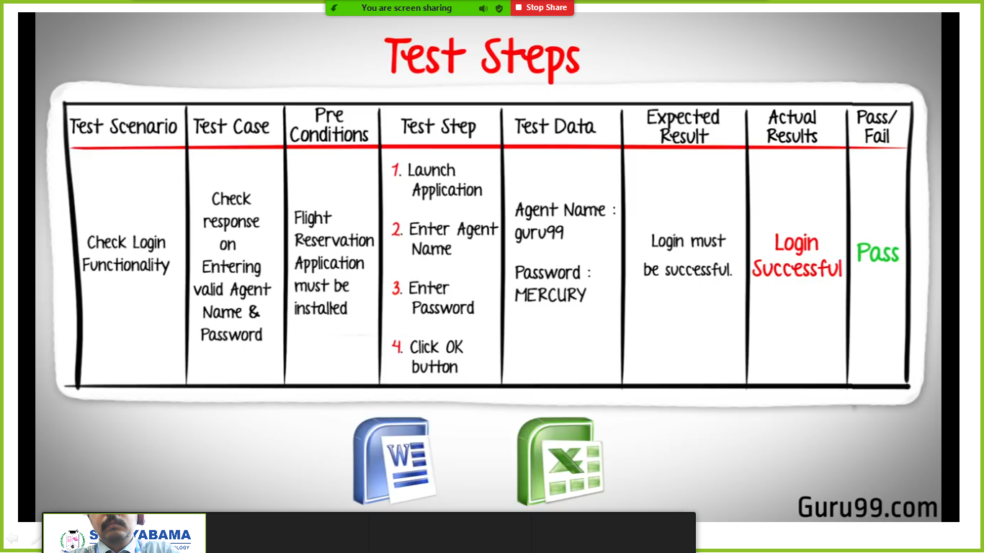

Slide 26
BLACK BOX TESTING
Black box testing involves testing a system with no prior knowledge of its internal workings.
A tester provides an input, and observes the output generated by the system under test. ... Black box testing is a powerful testing technique because it exercises a system end-to-end.

Slide 27
White box testing
White-box testing is a method of software testing that tests internal structures or workings of an application, as opposed to its functionality.
In white-box testing an internal perspective of the system, as well as programming skills, are used to design test cases.

Slide 28
White box testing
WHITE BOX TESTING (also known as Clear Box Testing, Open Box Testing, Glass Box Testing, Transparent Box Testing, Code-Based Testing or Structural Testing) is a software testing method in which the internal structure/design/implementation of the item being tested is known to the tester.

Slide 29
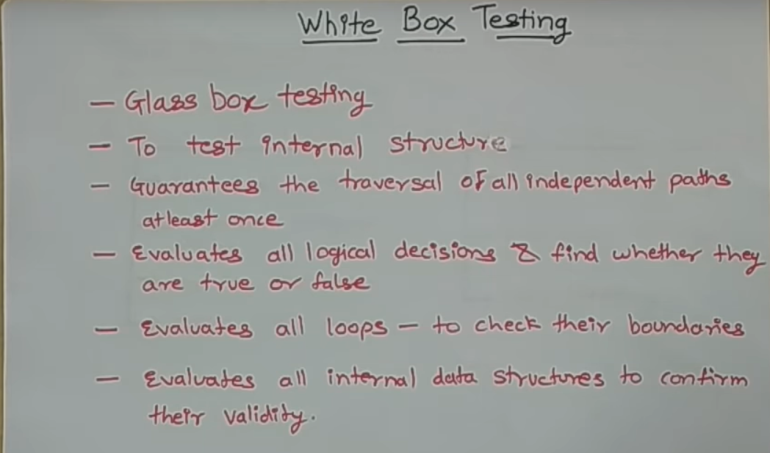

Slide 31
Basis path testing
In software engineering, Basis path testing, and Control structure testing, are two white box method for designing test cases.
The method analyzes the control flow graph of a program to find a set of linearly independent paths of execution

Slide 32
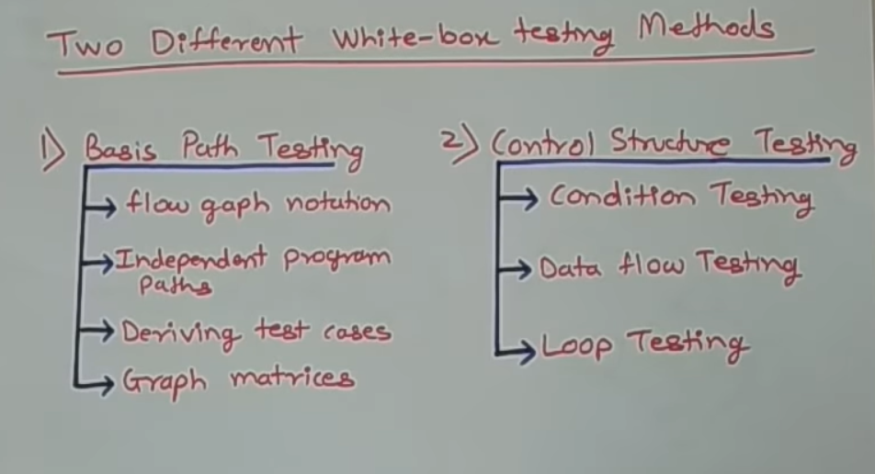

Slide 33
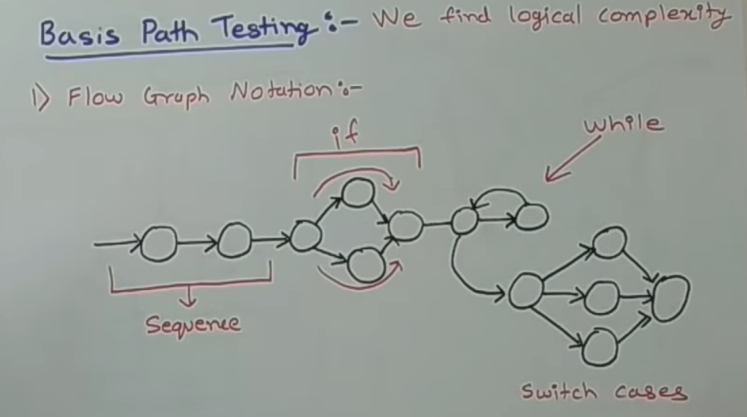

Slide 34
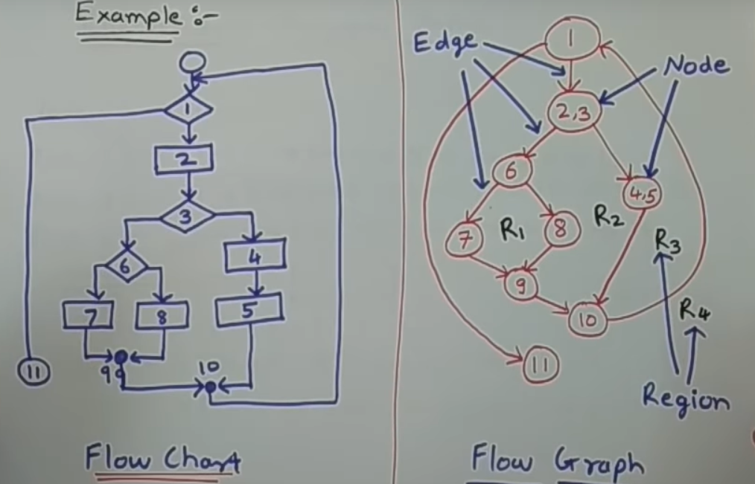

Slide 35
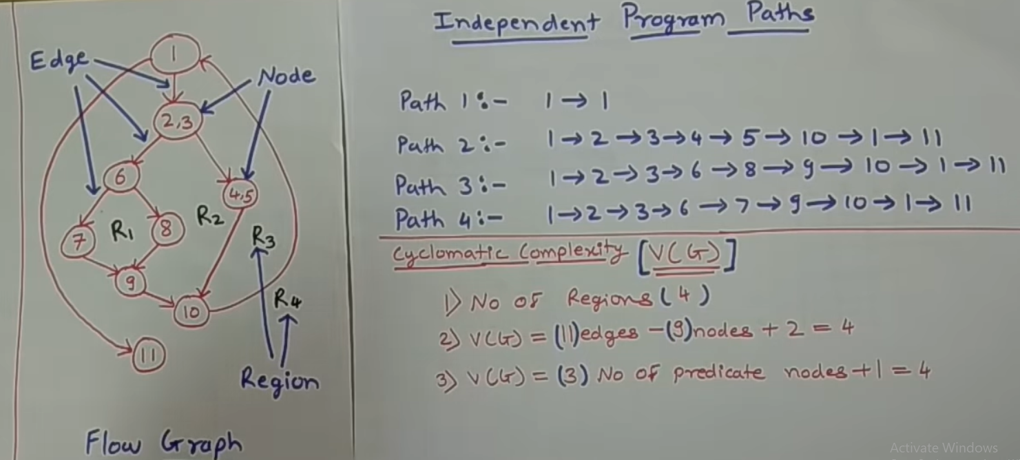
BY USING FLOW GRAPH WE CAN DERIVE 2 THINGS

Slide 36
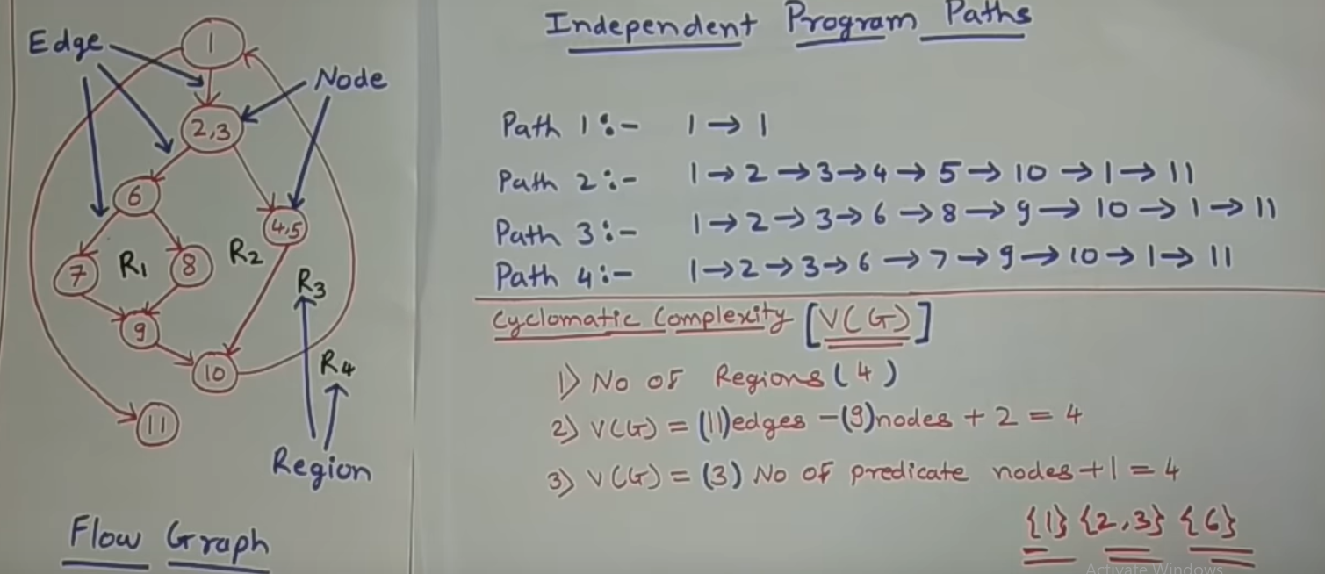

Slide 37
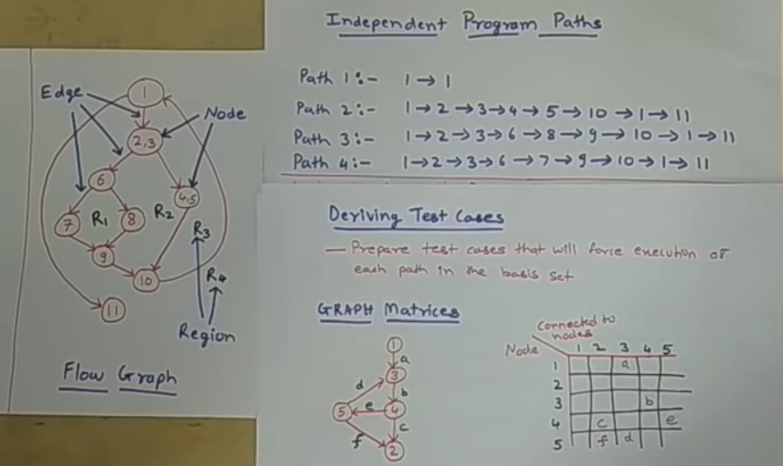

Slide 38
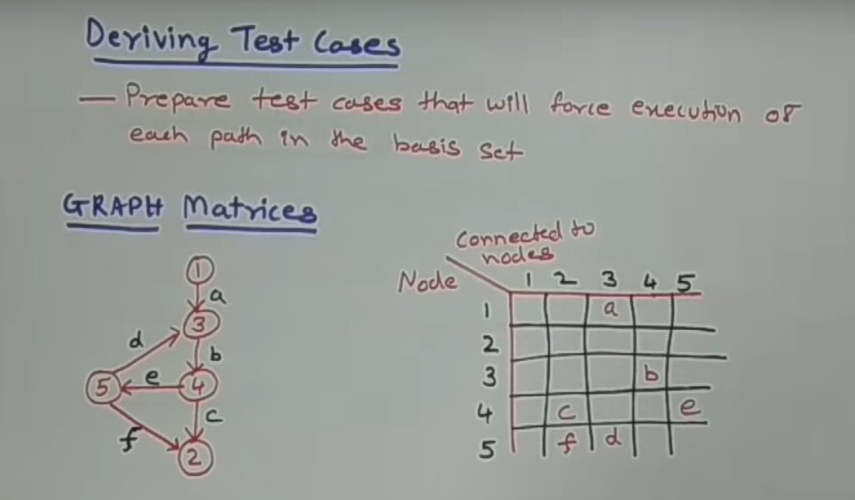

Slide 39
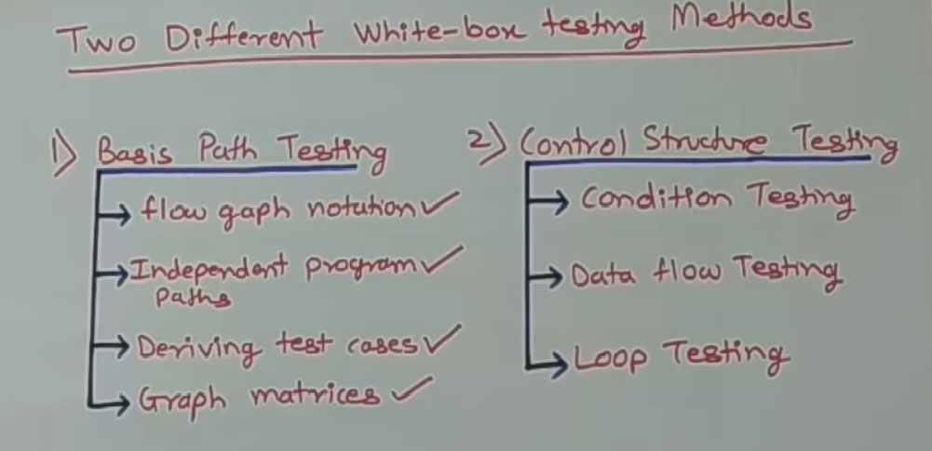

Slide 40
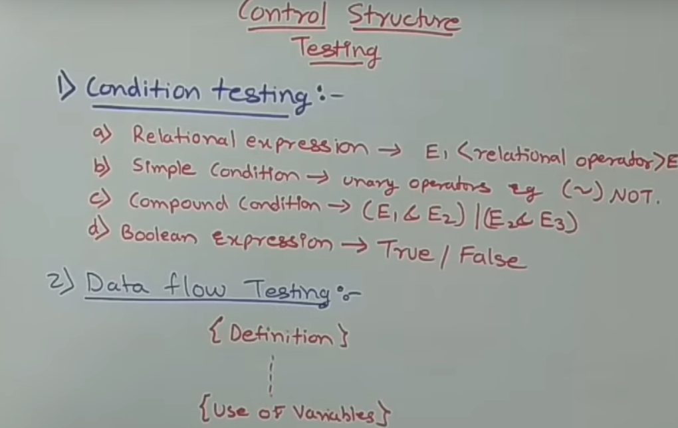

Slide 41
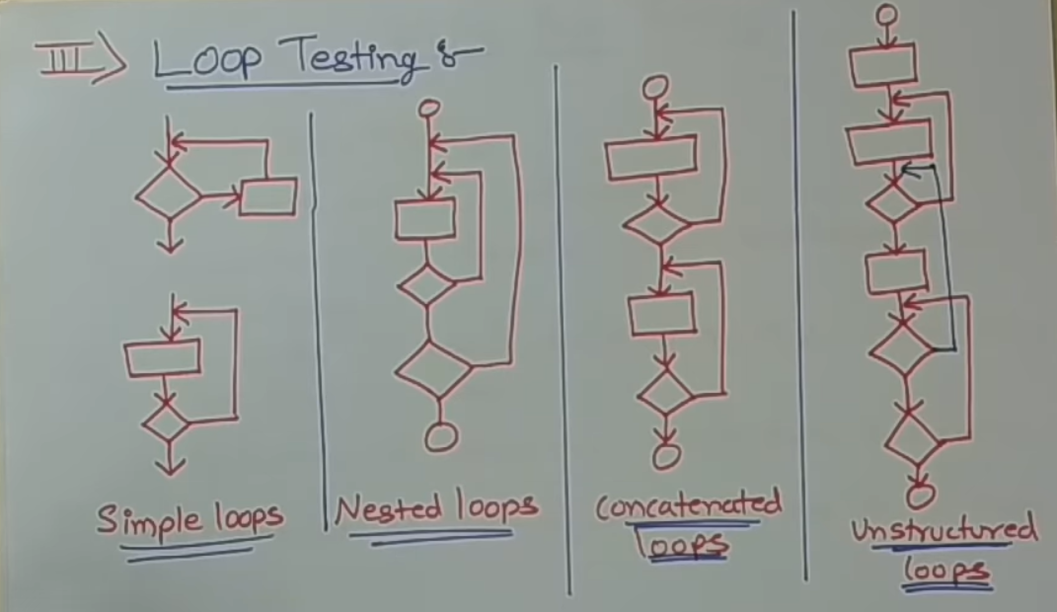

Slide 44
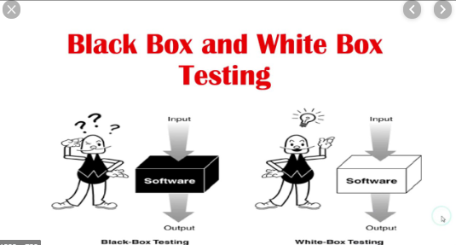

Slide 45
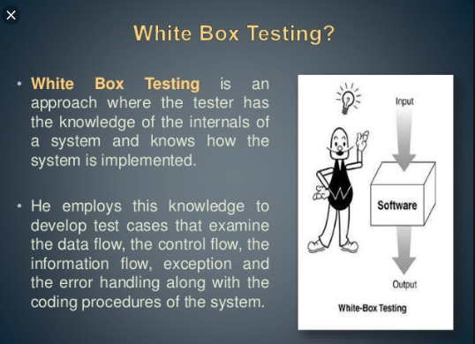

Slide 46
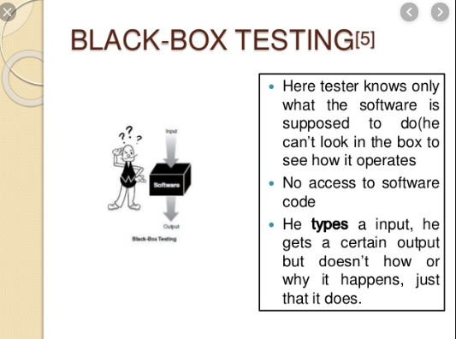

Slide 47
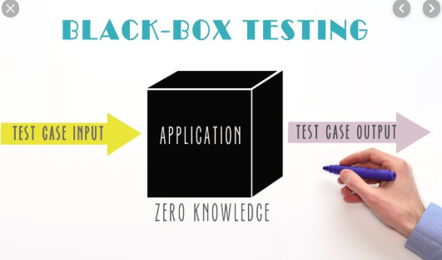

Slide 48
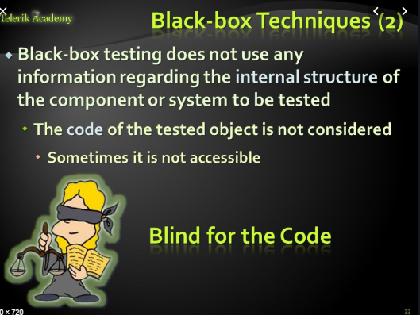

Slide 49
Black box testing
Black-box testing is a method of software testing that examines the functionality of an application without peering into its internal structures or workings.
This method of test can be applied virtually to every level of software testing: unit, integration, system and acceptance.

Slide 50
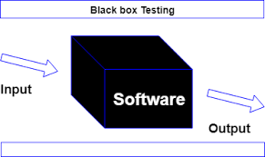

Slide 51
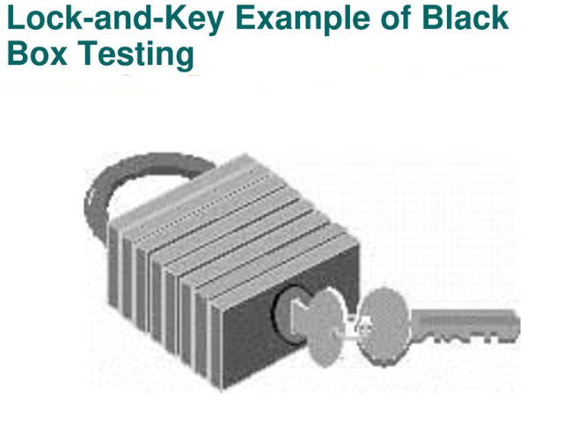

Slide 52
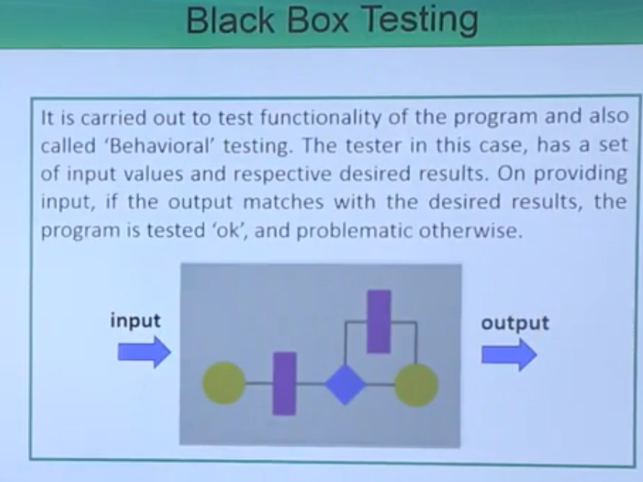

Slide 53
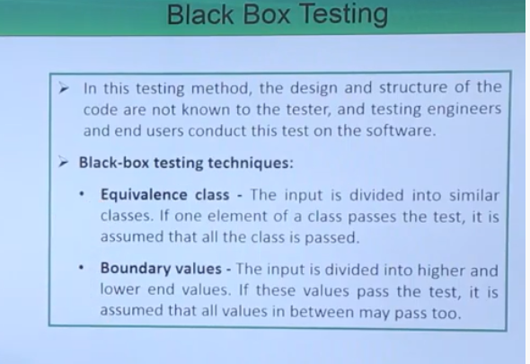

Slide 54
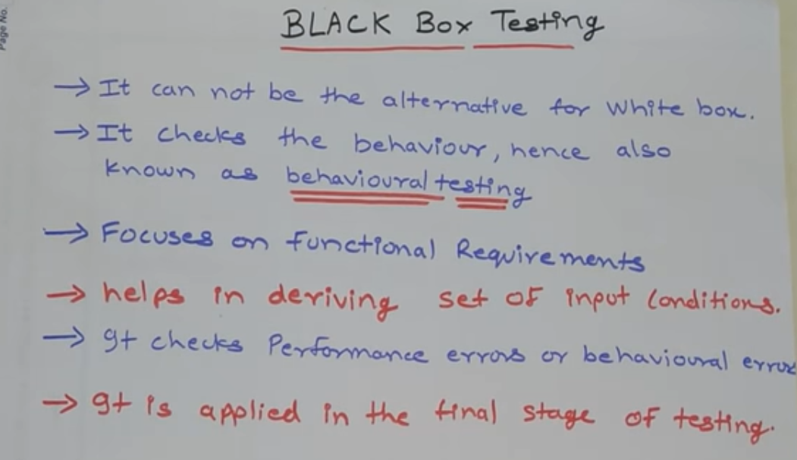

Slide 55
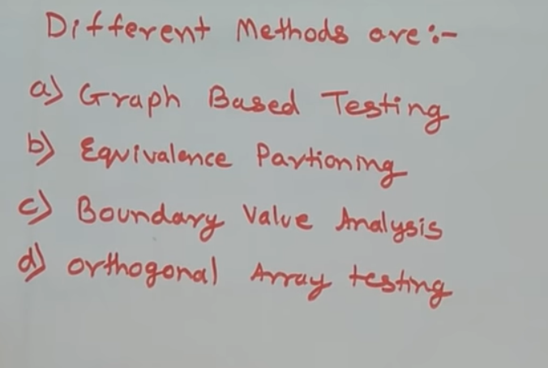

Slide 56
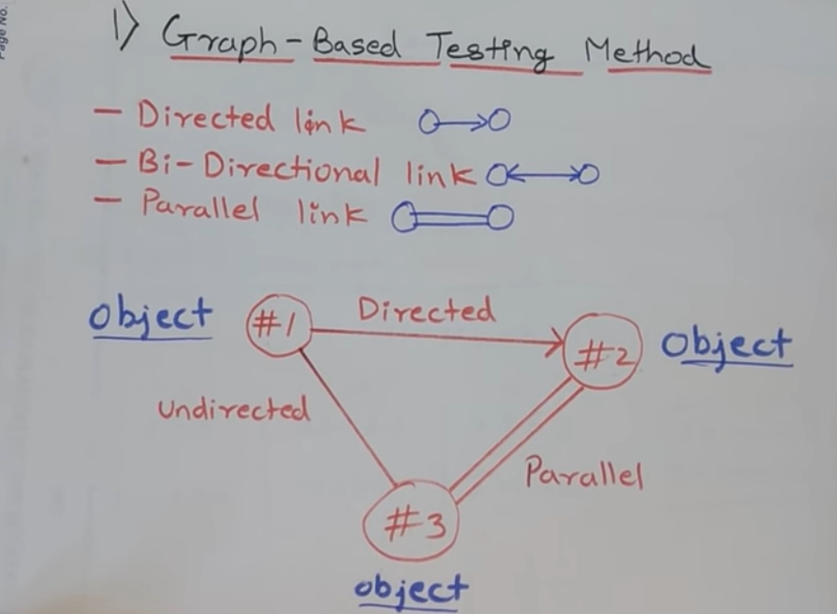

Slide 57
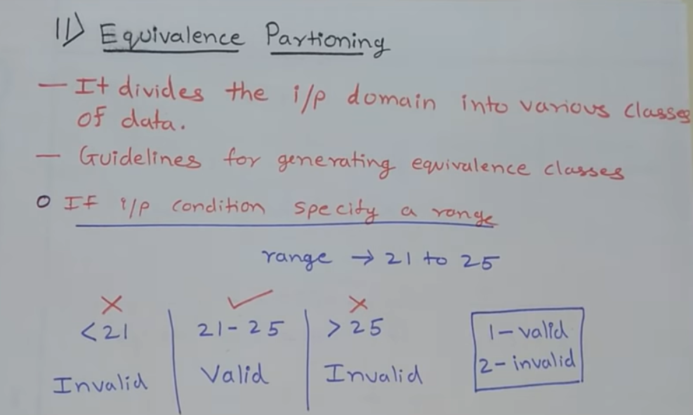

Slide 58
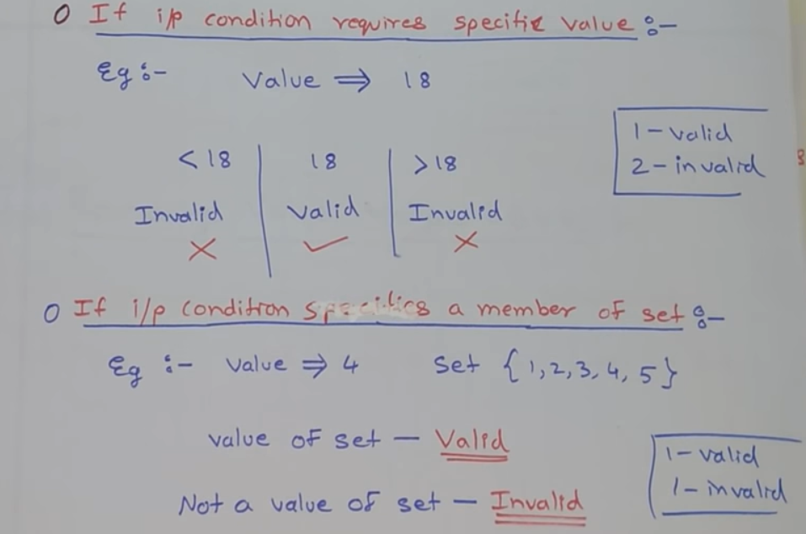

Slide 59
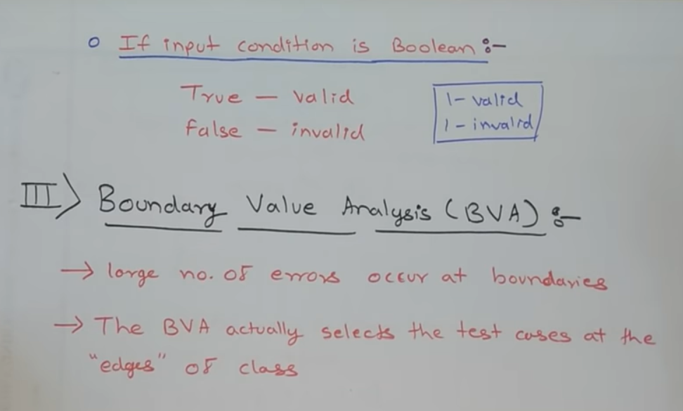

Slide 60
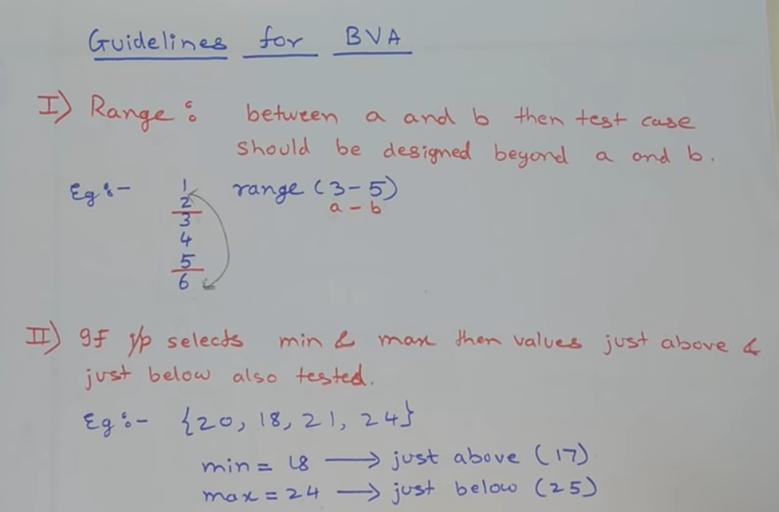

Slide 61
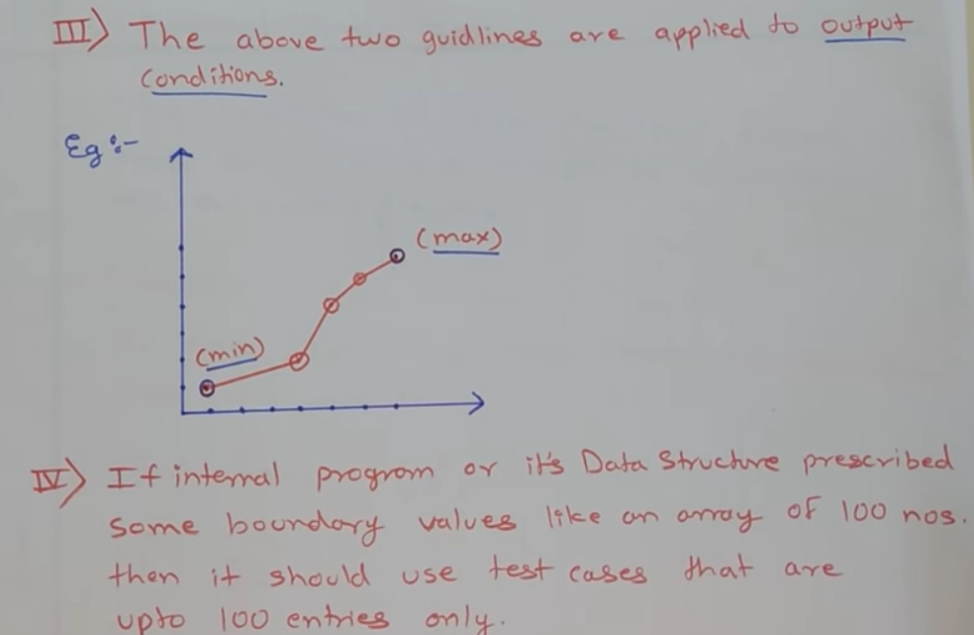

Slide 62
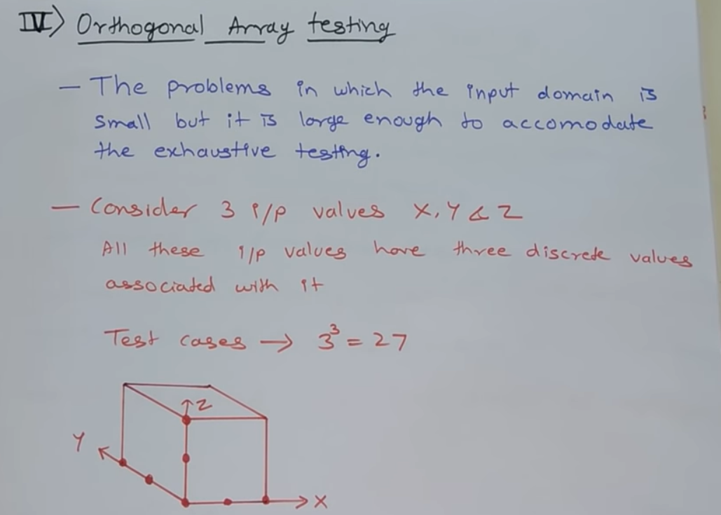

Slide 63
Gray-box testing
Gray-box testing is a combination of white-box testing and black-box testing. The aim of this testing is to search for the defects if any due to improper structure or improper usage of applications

Slide 64
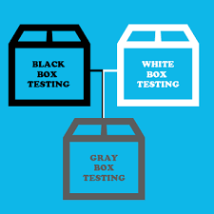
Gray-box testing

Slide 65
Regression testing

Slide 74
When to aplly Regression Testing?

Slide 89
UNIT TESTING

Slide 90
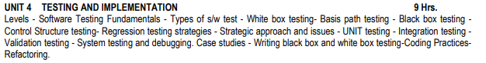
SYLLABUS

Slide 91
UNIT TESTING
is a level of the software testing process where individual units/components of a software/system are tested.
The purpose is to validate that each unit of the software performs as designed.

Slide 92
UNIT TESTING
a method by which individual units of source code are tested to determine if they are fit for use
concerned with functional correctness and completeness of individual program units
typically written and run by software developers to ensure that code meets its design and behaves as intended.
Its goal is to isolate each part of the program and show that the individual parts are correct.

Slide 93
What is Unit Testing
Concerned with
Functional correctness and completeness
Error handling
Checking input values (parameter)
Correctness of output data (return values)
Optimizing algorithm and performance

Slide 94
Types of testing
Black box testing – (application interface, internal module interface and input/output description)
White box testing- function executed and checked
Gray box testing - test cases, risks assessments and test methods

Slide 95
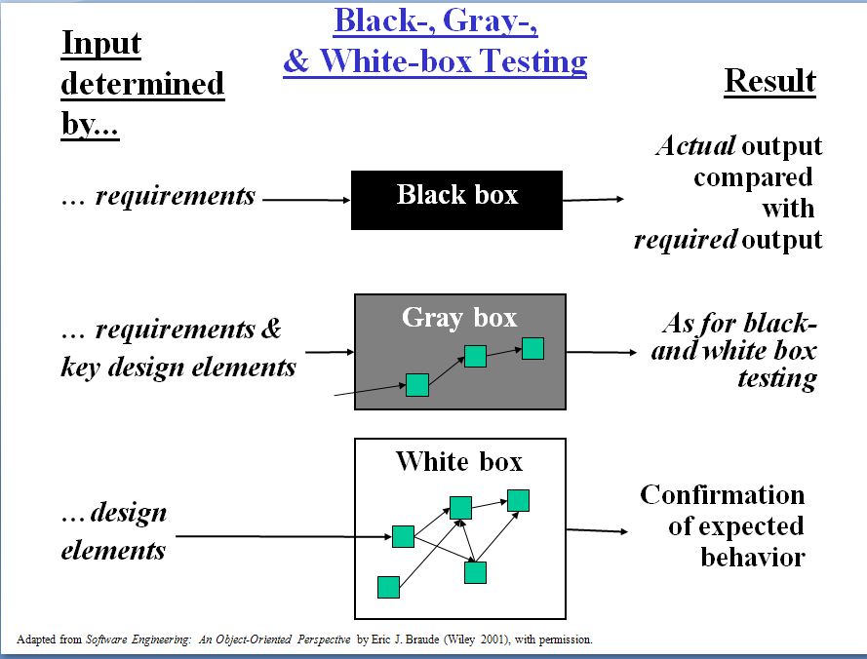

Slide 96
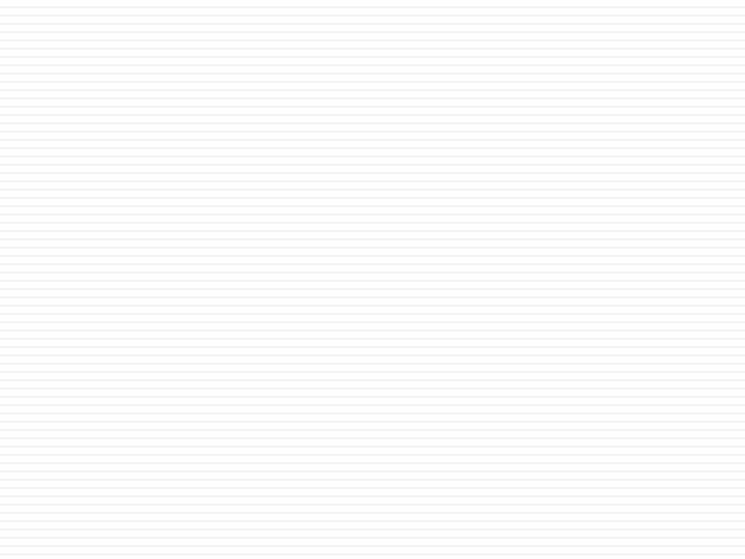
Traditional testing vs Unit
Testing

Slide 97
Traditional Testing
Test the system as a whole
Individual components rarely tested
Errors go undetected
Isolation of errors
difficult to track down

Slide 98
Traditional Testing Strategies
Print Statements
Use of Debugger
Debugger Expressions
Test Scripts

Slide 99
Unit Testing
Each part tested individually
All components tested at least once
Errors picked up earlier
Scope is smaller, easier to fix errors

Slide 100
Unit Testing Ideals
Isolatable
Repeatable
Automatable
Easy to Write

Slide 101
Why Unit Test?
Faster Debugging
Faster Development
Better Design
Excellent Regression Tool
Reduce Future Cost

Slide 102
BENEFITS
Unit testing allows the programmer to refactor code at a later date, and make sure the module still works correctly.
By testing the parts of a program first and then testing the sum of its parts, integration testing becomes much easier.
Unit testing provides a sort of living documentation of the system.

Slide 103
GUIDELINES
Keep unit tests small and fast
Ideally the entire test suite should be executed before every code check in. Keeping the tests fast reduce the development turnaround time.
Unit tests should be fully automated and non-interactive
The test suite is normally executed on a regular basis and must be fully automated to be useful. If the results require manual inspection the tests are not proper unit tests.

Slide 104
GUIDELINES
Make unit tests simple to run
Configure the development environment so that single tests and test suites can be run by a single command or a one button click.
Measure the tests
Apply coverage analysis to the test runs so that it is possible to read the exact execution coverage and investigate which parts of the code is executed and not.

Slide 105
GUIDELINES
Fix failing tests immediately
◉ Each developer should be responsible for making sure a new test runs successfully upon check in, and that all existing tests runs successfully upon code check in. If a test fails as part of a regular test execution the entire team should drop what they are currently doing and make sure the problem gets fixed.

Slide 106
GUIDELINES
Keep testing at unit level
◉ Unit testing is about testing classes. There should be one test class per ordinary class and the class behaviour should be tested in isolation. Avoid the temptation to test an entire work-flow using a unit testing framework, as such tests are slow and hard to maintain. Work-flow testing may have its place, but it is not unit testing and it must be set up and executed independently.

Slide 107
GUIDELINES
Start off simple
◉ One simple test is infinitely better than no tests at all. A simple test class will establish the target class test framework, it will verify the presence and correctness of both the build environment, the unit testing environment, the execution environment and the coverage analysis tool, and it will prove that the target class is part of the assembly and that it can be accessed.

Slide 108
GUIDELINES
Keep tests independent
To ensure testing robustness and simplify maintenance, tests should never rely on other tests nor should they depend on the ordering in which tests are executed.
Name tests properly
Make sure each test method test one distinct feature of the class being tested and name the test methods accordingly. The typical naming convention is test[what] such As testSaveAs(), testAddListener(), testDeleteProperty() etc.

Slide 109
GUIDELINES
Keep tests close to the class being tested
◉ If the class to test is Foo the test class should be called FooTest (not TestFoo) and kept in the same package (directory) as Foo. Keeping test classes in separate directory trees makes them harder to access and maintain. Make sure the build environment is configured so that the test classes doesn't make its way into production libraries or executables.

Slide 110
GUIDELINES
Test public API
◉ Unit testing can be defined as testing classes through their public API. Some testing tools makes it possible to test private content of a class, but this should be avoided as it makes the test more verbose and much harder to maintain. If there is private content that seems to need explicit testing, consider refactoring it into public methods in utility classes instead. But do this to improve the general design, not to aid testing.

Slide 111
GUIDELINES
Think black-box
Act as a 3rd party class consumer, and test if the class fulfills its requirements. And try to tear it apart.
Think white-box
After all, the test programmer also wrote the class being tested, and extra effort should be put into testing the most complex logic.

Slide 112
GUIDELINES
Test the trivial cases too
It is sometimes recommended that all non-trivial cases should be tested and that trivial methods like simple setters and getters can be omitted.
However, there are several reasons why trivial cases should be tested too:
Trivial is hard to define. It may mean different things to different people.
From a black-box perspective there is no way to know
which part of the code is trivial.
The trivial cases can contain errors too, often as a result of copy-paste operations:

Slide 113
GUIDELINES
Focus on execution coverage first
◉ Differentiate between execution
coverage and actual test coverage. The initial goal of a test should be to ensure high execution coverage. This will ensure that the code is actually executed on some input parameters.
When this is in place, the test coverage should be improved. Note that actual test coverage cannot be easily measured (and is always close to 0% anyway).

Slide 114
GUIDELINES
Cover boundary cases
◉ Make sure the parameter boundary cases are covered. For numbers, test negatives, 0, positive, smallest, largest, NaN, infinity, etc. For strings test empty string, single character string, non-ASCII string, multi-MB strings etc. For collections test empty, one, first, last, etc. For dates, test January 1, February 29, December 31 etc. The class being tested will suggest the boundary cases in each specific case. The point is to make sure as many as possible of these are tested properly as these cases are the prime candidates for errors.

Slide 115
GUIDELINES
Provide a random generator
◉ When the boundary cases are covered, a simple way to improve test coverage further is to generate random parameters so that the tests can be executed with different input every time.
To achieve this, provide a simple utility class that generates random values of the base types like doubles, integers, strings, dates etc. The generator should produce values from the entire domain of each type.

Slide 116
GUIDELINES
Test each feature once
◉ When being in testing mode it is sometimes tempting to assert on "everything" in every test. This should be avoided as it makes maintenance harder. Test exactly the feature indicated by the name of the test method. As for ordinary code, it is a goal to keep the amount of test code as low as possible.

Slide 117
GUIDELINES
Use explicit asserts
◉ Always prefer assertEquals(a, b) to assertTrue(a
== b) (and likewise) as the former will give more useful information of what exactly is wrong if the test fails. This is in particular important in combination with random value parameters as described above when the input values are not known in advance.

Slide 118
GUIDELINES
Provide negative tests
Negative tests intentionally misuse the code and verify robustness and appropriate error handling.
Design code with testing in mind
Writing and maintaining unit tests are costly, and minimizing public API and reducing cyclomatic complexity in the code are ways to reduce this cost and make high-coverage test code faster to write and easier to maintain.

Slide 119
GUIDELINES
Don't connect to predefined external resources
◉ Unit tests should be written without explicit knowledge of the environment context in which they are executed so that they can be run anywhere at anytime. In order to provide required resources for a test these resources should instead be made available by the test itself.

Slide 120
GUIDELINES
Know the cost of testing
Not writing unit tests is costly, but writing unit tests is costly too. There is a trade-off between the two, and in terms of execution coverage the typical industry standard is at about 80%.
Prioritize testing
Unit testing is a typical bottom-up process, and if there is not enough resources to test all parts of a system priority should be put on the lower levels first.

Slide 121
GUIDELINES
Prepare test code for failures
◉ If the first assertion is false, the code crashes in the subsequent statement and none of the remaining tests will be executed. Always prepare for test failure so that the failure of a single test doesn't bring down the entire test suite execution.

Slide 122
GUIDELINES
Write tests to reproduce bugs
When a bug is reported, write a test to reproduce the bug (i.e. a failing test) and use this test as a success criteria when fixing the code.
Know the limitations
Unit tests can never prove the correctness of code.

Slide 123
Unit Testing Techniques:
Structural, Functional & Error based Techniques
Structural Techniques:
◉ It is a White box testing technique that uses an internal perspective of the system to design test cases based on internal structure. It requires programming skills to identify all paths through the software. The tester chooses test case inputs to exercise paths through the code and determines the appropriate outputs.

Slide 124
Major Structural techniques are:
Statement Testing: A test strategy in which each statement of a program is executed at least once.
Branch Testing: Testing in which all branches in the program source code are tested at least once.
Path Testing: Testing in which all paths in the program source code are tested at least once.
Condition Testing: Condition testing allows the programmer to determine the path through a program by selectively executing code based on the comparison of a value
Expression Testing: Testing in which the application is tested for different values of Regular Expression.

Slide 125
Unit Testing Techniques:
Functional testing techniques:
These are Black box testing techniques which tests the functionality of the application.

Slide 126
Some of Functional testing techniques
Input domain testing: This testing technique concentrates on size and type of every input object in terms of boundary value analysis and Equivalence class.
Boundary Value: Boundary value analysis is
a software testing design technique in which tests are designed to include representatives of boundary values.
Syntax checking: This is a technique which is used to check the Syntax of the application.
Equivalence Partitioning: This is a software testing technique that divides the input data of a software unit into partition of data from which test cases can be derived

Slide 127
Unit Testing Techniques:
Error based Techniques:
The best person to know the defects in his code is the person who has designed it.

Slide 128
Few of the Error based techniques
Fault seeding techniques can be used so that known defects can be put into the code and tested until they are all found.
Mutation Testing: This is done by mutating certain statements in your source code and checking if your test code is able to find the errors. Mutation testing is very expensive to run, especially on very large applications.
Historical Test data: This technique calculates the priority of each test case using historical information from the previous executions of the test case.

